Slide 1
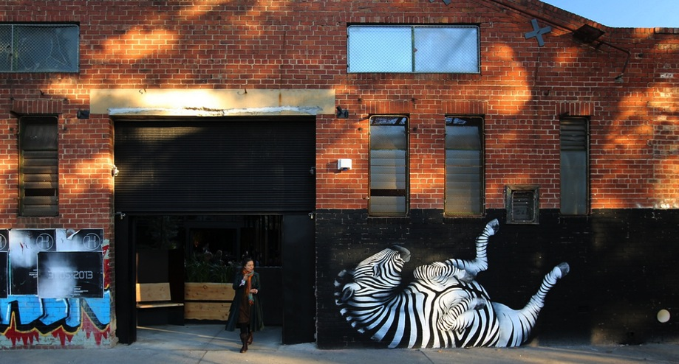
Reservoir Laneways Project
Branding the identity of a community spirit - by exciting and inviting your community to get involved, followed up with public art best practice and good maintenance.

Slide 2
Reservoir Laneways Project
CONTENTS
1
2
3
4-6
7
8-11
12
13
14
15
APPROACH…………………………………………………………………………………………………………………………………………
COMMUNITY………………………………………………………………………………………………………………………………………
RESEARCH………………………………………………………………………………………………………………………………………….
PREVIOUS WORK………………………………………………………………………………………………………………………………
SITE ASSESSMENT……………………………………………………………………………………………………………………………….
CONCEPTS ……………………………………………………………………………………………………………………………………………….
LOGISTICS/ MATERIALS……………………………………………………………………………………………………………………………………………….
SAFE WORK METHOD/ INSURANCE……………………………………………………………………………………………………………………………………………….
TIMELINE/ APPLICATION/ COST………………………………………………………………………………………………………….………………………………
MAINTENANCE/ POST CARE………………………………………………………………………………………………………………………………………………

Slide 3
Reservoir Laneways Project
APPROACH
In response to the Reservoir Laneways Project brief, I would firstly like to express my gratitude for the opportunity to present ideas, along with the chance to creatively collaborate with the residents and traders in my local area.
As a resident of Northcote/Reservoir for over 15 years, it would be a joy to plant some creativity and continue to produce work in partnership with our vibrant communities. Having worked closely with the Northcote High St Traders Association, the Darebin City Council, Monash City Council, City of Banyule, as well as the High street, Coburg Traders and Niddrie Trader’s Associations on recent creative projects, I fully appreciate the delicacy and honor of bringing art to a community, along with it’s various benefits.
Whilst painting a mural in public space, I am given a unique opportunity to engage with the passer-by. I’m able to explain why the work is happening, what it is about and who is investing the space.
People are often surprised and happy to hear the Council are putting energy into building the creative culture and identity of an area. I’m always articulate and welcoming of conversations as it is a big part of the art making. Those that do stop find a deeper connection to the work, as they ‘spoke to the artist’ while it was in production, and shared their story. Successful mural imagery needs to be more than just decorative. When a resident walks past a piece of work, they need to feel a connection to the work, and enjoy the skill of a well executed piece. The Reservoir Laneway Project has the potential to challenge and inspire locals, whilst contributing to the aesthetic of the area and a growing community. Connecting the creative corridor along the north from the laneways of our CBD through Fitzroy and Northcote.
Should you consider my proposal, I would like to suggest that the future scope for application reaches much further than beautifying damaged and tired communal spaces. The opportunity for using these images for further branding, print application, thematic events and artistic expression, paints a virtual framework for any future creative engagement you may have in the community.
Philosophy
1

Slide 4
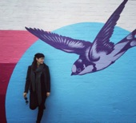
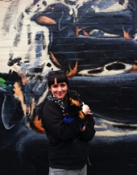
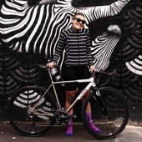
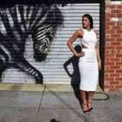
Reservoir Laneways Project
COMMUNITY
Having worked in areas that boast enormous diversity in cultural backgrounds, there has been an interesting trend in how people respond to various images. Particularly working on animal or botanical illustrations, people will often stop to tell me their history or association with that animal. It is easy to project a meaning onto universally celebrated themes.
During my time in Coburg painting the swallows, an old Irish retired fisherman told me why you see so many seamen with swallow tattoos. The owner of the building was Lebanese and also explained the deep cultural significance of birds in flight, particularly for immigrants.
Painting the Mitchell Street wall in Northcote (2009), I was working on the “Stack of long dogs” when a woman spent her afternoon cooing about her Daschund, she later returned to bring the dog for a photo (and some welcome life-modelling). When repainting the wall again in 2017, she returned with a new puppy and told me of the original artist she’d spoken with. I showed her our photo.
People want to be near to the work, to share it on social and celebrate it.
Finding a balance that satisfies an aesthetically pleasing artwork, and something that will anchor it’s self in the psyche of so many diverse backgrounds is another consideration for the subject matter in this proposal.
I consider the passer-by, the business owner and the resident all the owners of this work. I am keen to work in partnership with the community to develop something that will speak to as many people as possible.
During the Colours of Coburg project in 2017, I worked with the trader’s association as well as with key stakeholders within Moreland City Council to develop the final artworks. I’m comfortable running online or live consultation sessions to ensure everyone has an opportunity to provide input.
Understanding the audience
2

Slide 5
Reservoir Laneways Project
RESEARCH
Based on the insight from the recent Public Art In Darebin Survey (Dec 2017), the community has articulated some great preferences and ideas around public art. These have been taken into consideration with this expression of interest.
Artwork in Darebin is important, there is a strong drive to see more artwork as it can contribute to a sense of identity
The top three preferences in execution were:
Temporary (2 years)
Integrated design
Murals
Artworks that engages with it’s environment, adds value and acknowledges the heritage and/or future of an area
Work should be bold, surprising and inspiring
Intentional artwork that improves areas that are tagged or have graffiti feel more safe and appealing
Public art may bring more of the “Fitzroy/Northcote” feel to the area
This proposal is designed to illustrate a painted mural execution using traditional fine art methods of production.
Primarily using high quality paint applied with various brushes and rollers to achieve a range of stylistic results.
What the community want
3

Slide 6
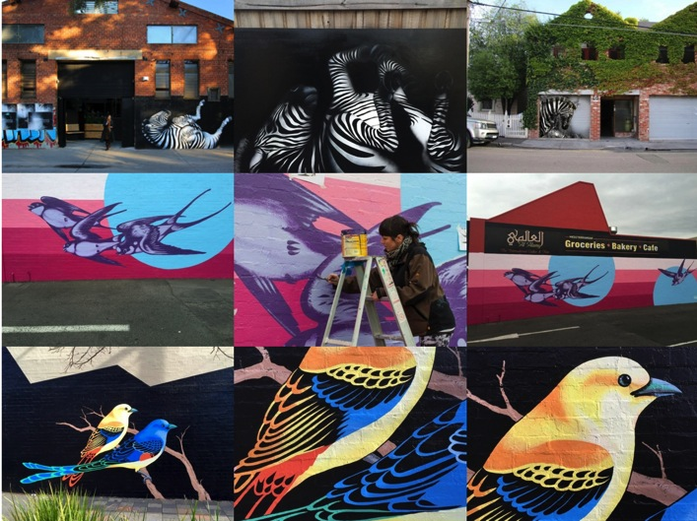
Reservoir Laneways Project
PREVIOUS WORK
More work available :
www.nessflett.com
4

Slide 7
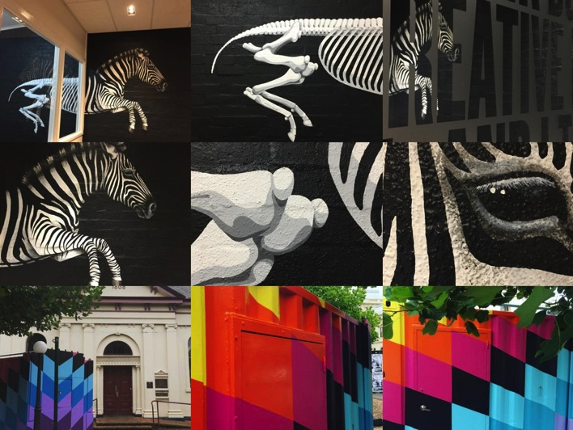
Reservoir Laneways Project
PREVIOUS WORK
More work available :
www.nessflett.com
5

Slide 8
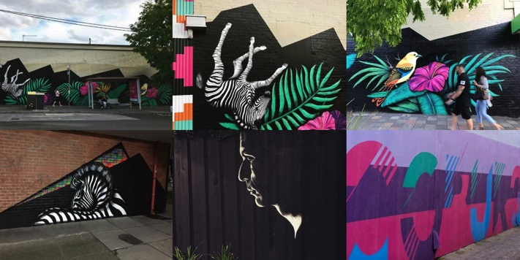
Reservoir Laneways Project
PREVIOUS WORK
More work available :
www.nessflett.com
6

Slide 9
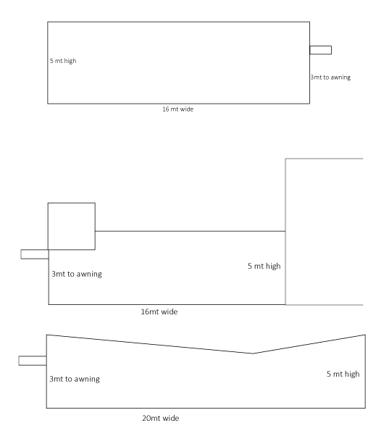
Reservoir Laneways Project
SITE ASSESSMENT
LOCATION 2
Painted surface
Street visibility
Single execution
LOCATION 1
Raw brick surface
Possible double execution
Wooden ‘rail’ on both buildings 1mt from ground
Not mirrored dimensions
7

Slide 10
Reservoir Laneways Project
$7,800
8

Slide 11
Reservoir Laneways Project
$8,700
9

Slide 12
Reservoir Laneways Project
$9,000
10

Slide 13
Reservoir Laneways Project
$9,500
11

Slide 14
Reservoir Laneways Project
LOGISTICS
Having assessed both locations, I have considered the complexities of each. As my method will be painting up to 5+ meters high, I will need to consult with Council on appropriate traffic management. Some restriction may be required to limit or slow automotive traffic. Pedestrian traffic can be easily managed with signage, temporary bollards and tape.
Location 1 will require more management as it seems to facilitate more cars. Some traffic management or restriction will need to be in place while I am operating at height with a platform ladder or scissor lift. This is easily accommodated and I have worked in these environment before.
Location 2 is a little more forgiving and would allow for ample room on a ladder/lift and automotive traffic.
Additional traffic management (i.e. bollards and high-vis tape) would be utilised to ensure public and artist safety. All with the consultation of council to ensure appropriate use of management.
Materials will include (but are not limited to) Dulux and Wattyl High Gloss, Water based enamel aerosol paint, stencils, tape and drop sheets. These ensure the fastest drying time, as well as the best quality colour stability in a UV environment.
Always utilizing safe material handling and off-site cleaning and brush maintenance procedures.
Safe work practice to be negotiated with council, full safety gas-mask to be utilized by the artist and restricted pedestrian access where appropriate.
The artist will be on site while paint is wet at all times.
MATERIALS
Planned and considered
12

Slide 15
Reservoir Laneways Project
SAFE WORK METHOD
While each site will be unique, I will undertake a risk-assessment of each location and provide detail on how I will be producing work for each site. There are several work methods that can be engaged to ensure both mine and public safety:
Working above 2 meters on any wall, I utilise an industrial (not domestic) ladder. This ladder would be placed at a slope of 4 (vertical) to 1 (horizontal) and appropriately tied-off and secured where appropriate.
Alternatively I will be making use of the scissor-lift for larger works over 3 meter and under 11mt. The cost of this is calculated in any works over 3-4 meters. I am fully certified to operate this machinery.
I would also be engaging in the work during business hours and over the weekend during the day so there is no risk of low-light accident, and high-visibility and “wet paint” barriers will be used to redirect both automotive and pedestrian traffic where required.
Should my proposal be successful, I will purchase the necessary PLI insurance as required.
INSURANCE
Ensuring safety
13

Slide 16
Reservoir Laneways Project
TIMELINE
April 2018 – Consultation
May 2018 – Creative development
June 2018 – Installation
I am available for all of the above timeframes should my proposal be successful
The initial concepts shown on pages 8-11 are designed to provide indicative pricing for each location, based on complexity.
My application is for both sites, as I believe this is a great opportunity to develop a visual language that could be rolled out across multiple locations as a series of artworks. We could develop a suitable group of work that would have a relationship.
However the designs are not dependant on both walls, so I would be happy to work on just one (with the preference for Laneway 2).
The estimate per site would be between $7,800 - $9,500 depending on the complexity and dimension of the final artwork.
I will need to consider the hire of an industrial lift/platform ladder as well as additional paints to cover the surface area.
I operate in the capacity as a hobbyist, and will be happy to provide you with the appropriate paperwork to document this. I provide all clients with an invoice, an ABN and will require part payment up front to cover the cost of materials and hire.
APPLICATION
COST
Taking the time
14

Slide 17
Reservoir Laneways Project
MAINTENANCE
The ability to tap into the pride of a community comes with consistency and a demonstration from it’s council that the image and presentation of it’s areas is important. Which is why the maintenance of the mural(s) and other communal spaces should be considered with priority, as the echoing effect of public confidence, sense of safety and pride aren’t to be underestimated.
I would suggest a clear-coat of a “graffiti-proof” paint that is easily maintained with a high pressure hose when council cleaners are working, be implemented once the work is complete. The cost of this is (as per the brief) not included in my pricing.
Should damages be unable to be cleaned, I will include a discounted hourly rate for the proceeding 12 months for any maintenance required on works.
As I am local, I will be monitoring the site(s) regularly and able to report any damages that require action.
Additional supports that have worked in the past on problem sites include dummy security cameras installed, and solar powered sensor lights.
POST CARE
A well-maintained idea
15

Slide 18
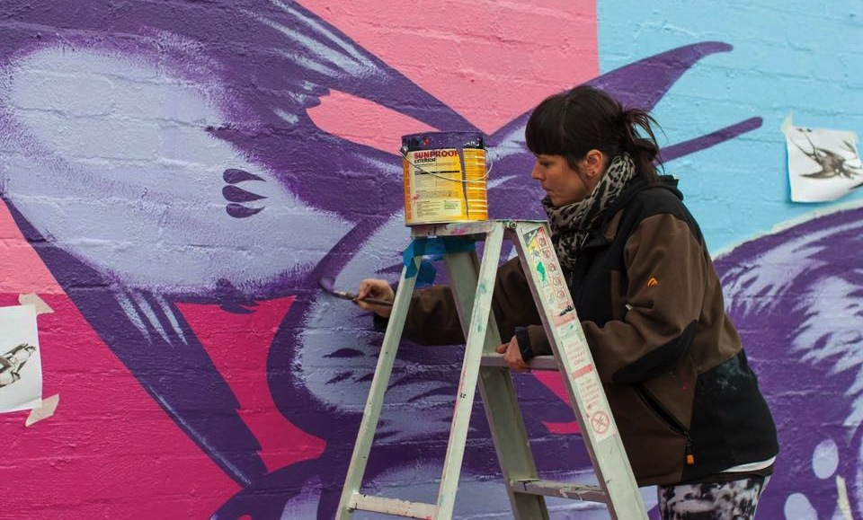
Reservoir Laneways Project
NESS FLETT
inbox@nessflett.com
0415531377

